Slide 1
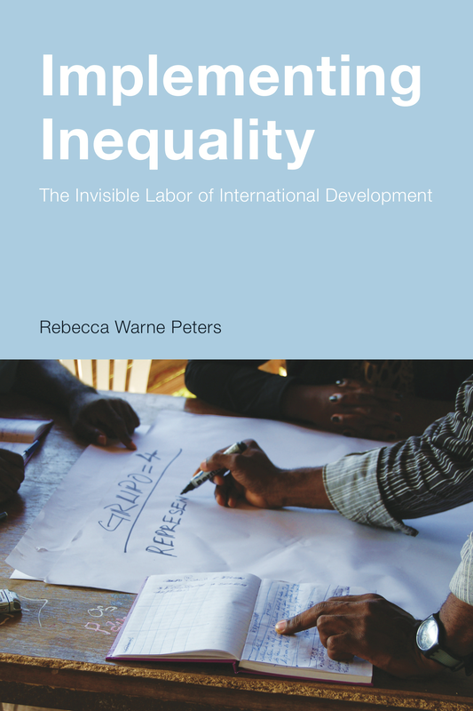
Implementing Inequality
The Invisible Labor of International Development

Slide 2
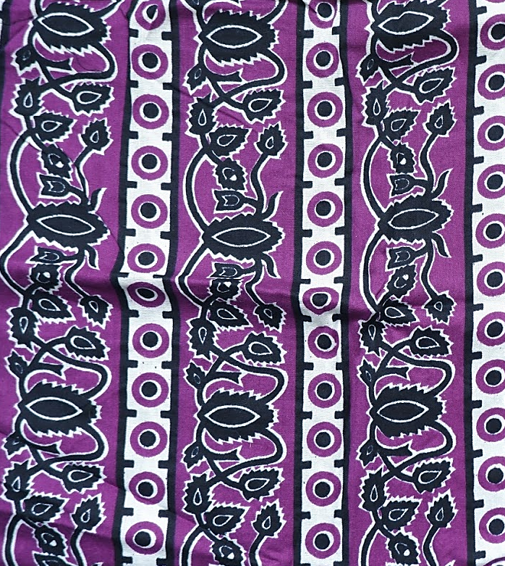
Angola:
Country
Overview

Slide 3
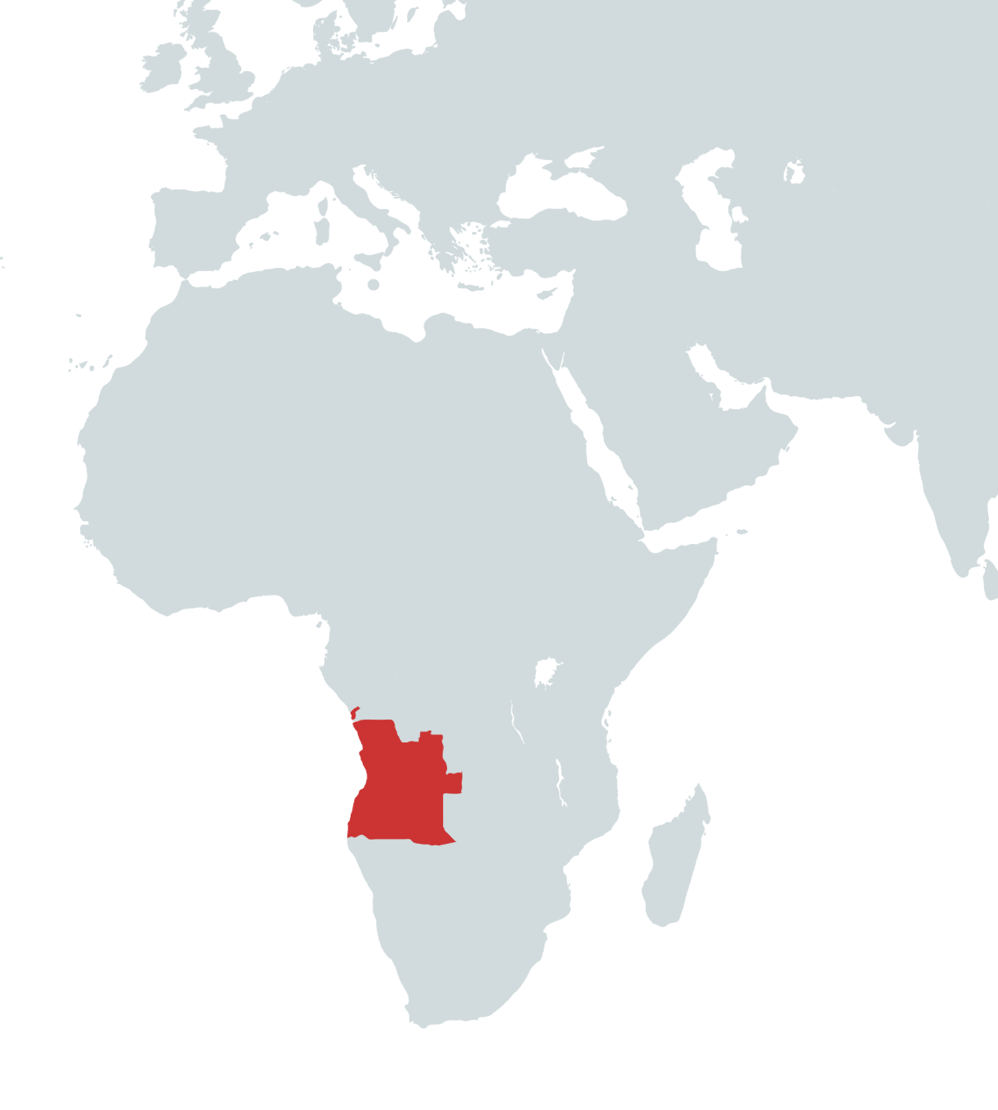
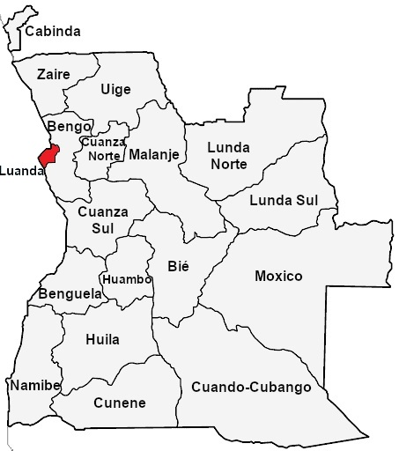
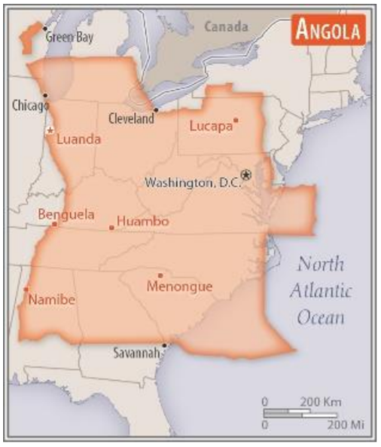
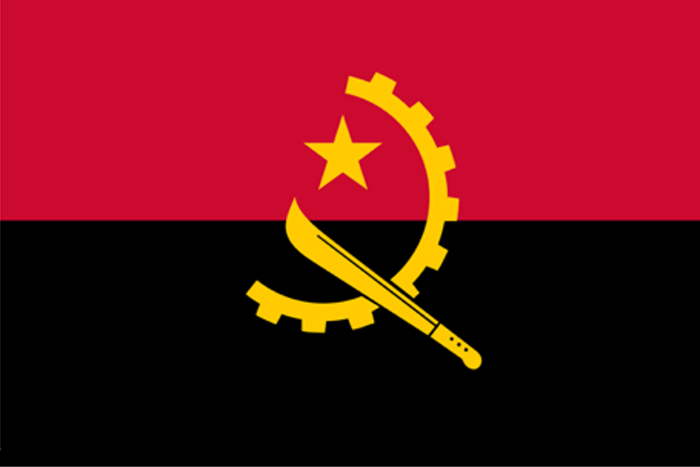

Country Overview
Geography
Capital: Luanda
18 provinces
Cabinda province is an enclave separated by DRC
Most people live in the western half of the country
Notes:
Additional notes from CIA World Factbook:
about eight times the size of Georgia; slightly less than twice the size of Texas
Climate semiarid in south and along coast to Luanda; north has cool, dry season (May to October) and hot, rainy season (November to April):
Terrain: narrow coastal plain rises abruptly to vast interior plateau
most people live in the western half of the country; urban areas account for the highest concentrations of people, particularly the capital of Luanda
Natural hazards: locally heavy rainfall causes periodic flooding on the plateau
Urban population=67.5% of total population
8.6 million in the capital of Luanda

Slide 4
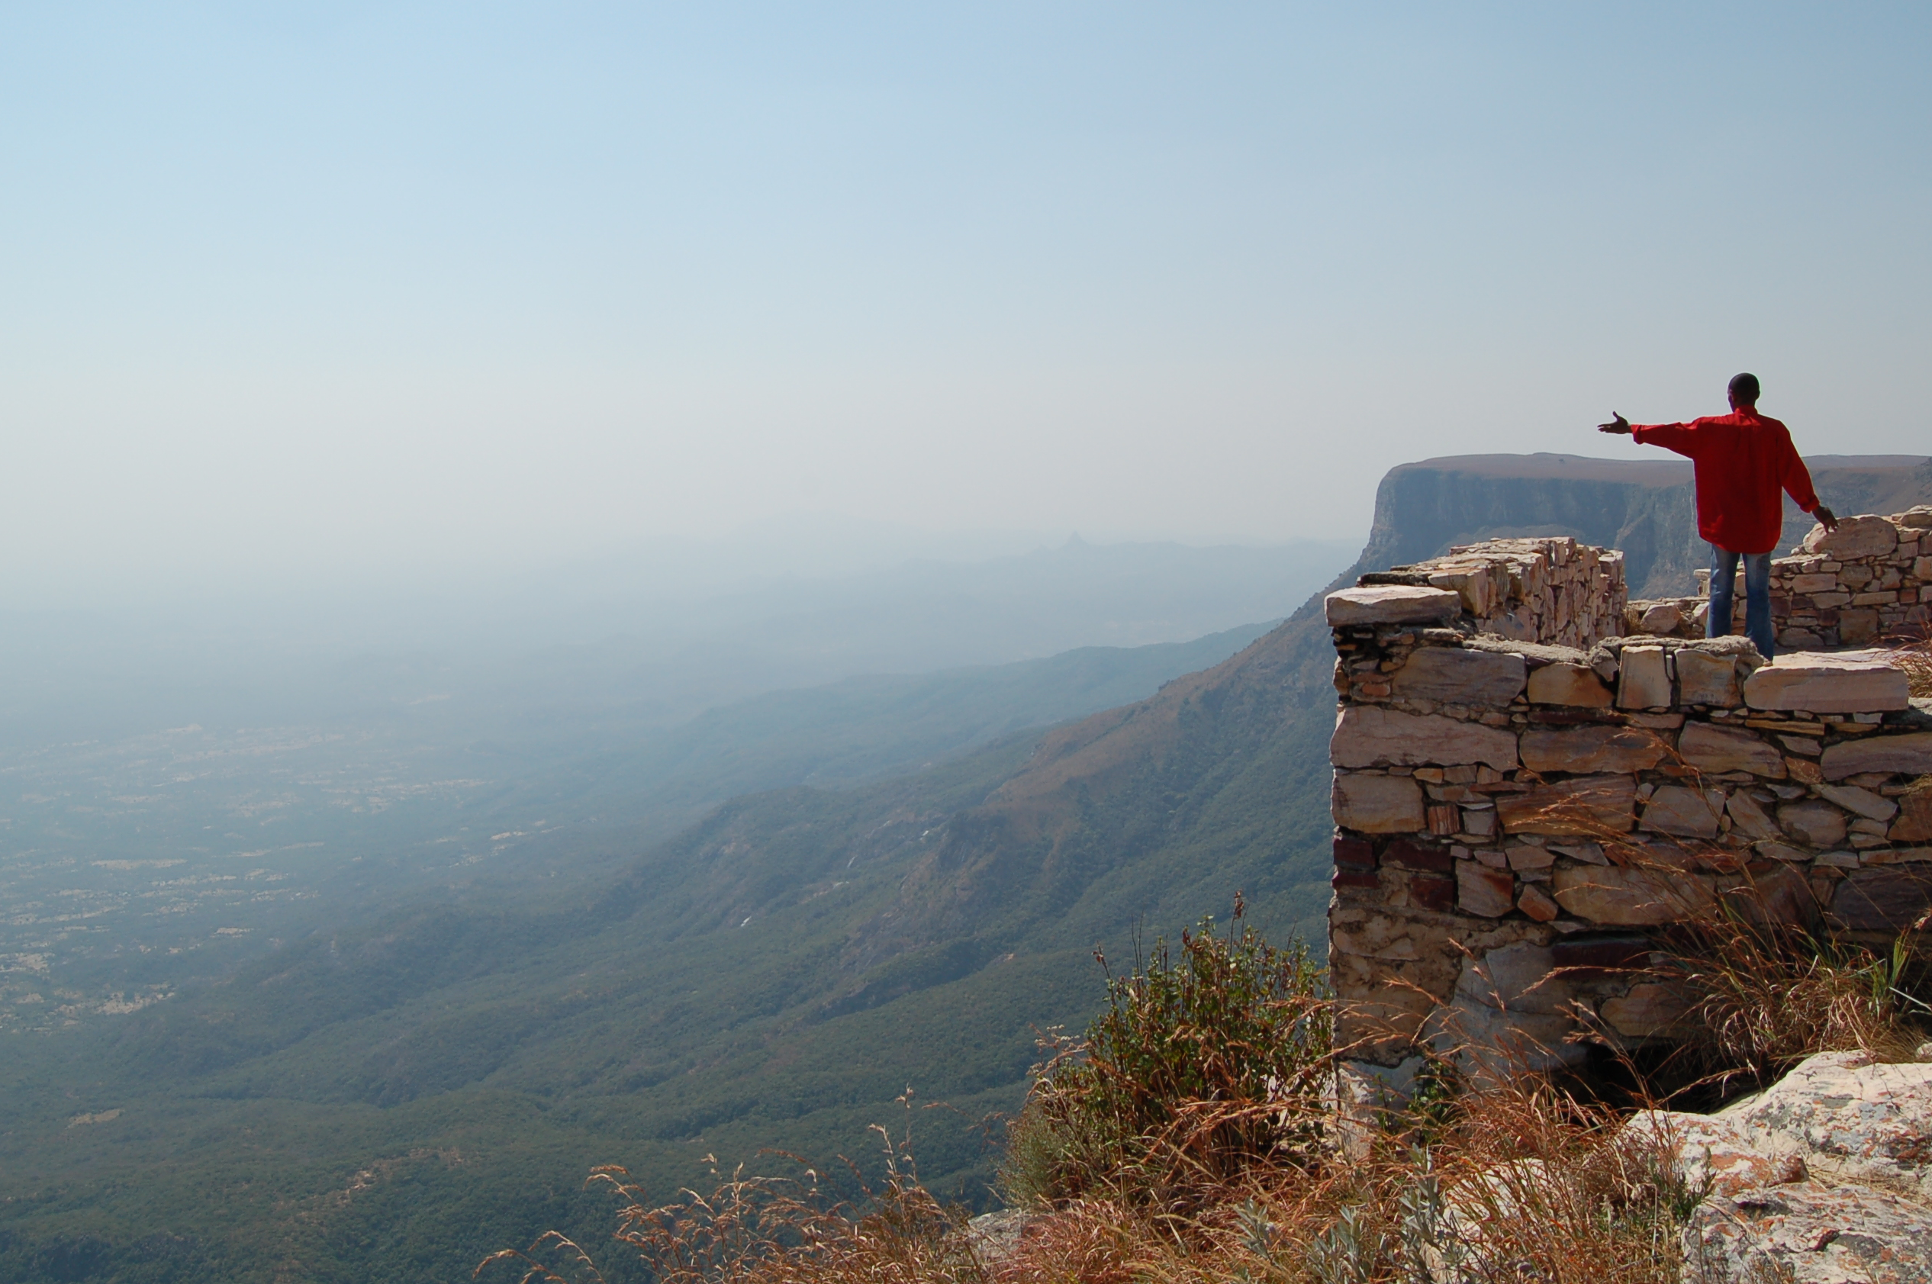
Country Overview
People
Official language: Portuguese
  Also: Umbundu, Kikongo, Kimbundu, Chokwe, & more
Population: 33.6 million
  Average age of 15.9
Key ethnic groups include Ovimbundu, Kimbundu, Bakongo
Religion: Roman Catholic, Protestant
Notes:
Additional notes from CIA World Factbook:
Ethnic groups: Ovimbundu 37%, Kimbundu 25%, Bakongo 13%, mestico (mixed European and native African) 2%, European 1%, other 22%
Languages: Portuguese 71.2% (official), Umbundu 23%, Kikongo 8.2%, Kimbundu 7.8%, Chokwe 6.5%, Nhaneca 3.4%, Nganguela 3.1%, Fiote 2.4%, Kwanhama 2.3%, Muhumbi 2.1%, Luvale 1%, other 3.6% (2014 est.) note: data represent most widely spoken languages; shares sum to more than 100% because some respondents gave more than one answer on the census
Religions: Roman Catholic 41.1%, Protestant 38.1%, other 8.6%, none 12.3% (2014 est.)
Population distribution: most people live in the western half of the country; urban areas account for the highest concentrations of people, particularly the capital of Luanda
Literacy (age 15+ who can read and write, 2015): total population- 71.1%; female- 60.7%; male- 82%)

Slide 5
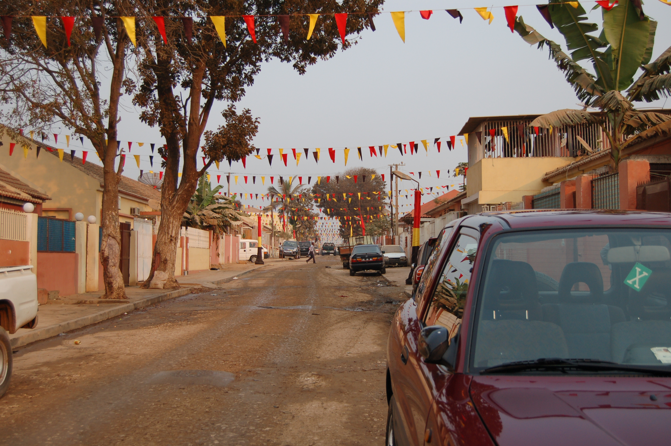
Country Overview
Economy
Driven by oil and supporting activities:
  50% of GDP
  70% government revenue
  90% of exports
GPD per capita is $6,670 (2019 est.)
  49.9% of population lives on less than $1.90/day (2018)
85% of labor force in agriculture
Currency: Kwanza
Notes:
Additional notes from CIA World Factbook:
Angola's economy is overwhelmingly driven by its oil sector. Oil production and its supporting activities contribute about 50% of GDP, more than 70% of government revenue, and more than 90% of the country's exports; Angola is an OPEC member and subject to its direction regarding oil production levels. Diamonds contribute an additional 5% to exports. Subsistence agriculture provides the main livelihood for most of the people, but half of the country's food is still imported.
Increased oil production supported growth averaging more than 17% per year from 2004 to 2008. A postwar reconstruction boom and resettlement of displaced persons led to high rates of growth in construction and agriculture as well. Some of the country's infrastructure is still damaged or undeveloped from the 27-year-long civil war (1975-2002). However, the government since 2005 has used billions of dollars in credit from China, Brazil, Portugal, Germany, Spain, and the EU to help rebuild Angola's public infrastructure. Land mines left from the war still mar the countryside, and as a result, the national military, international partners, and private Angolan firms all continue to remove them.
Continued low oil prices, the depreciation of the kwanza, and slower than expected growth in non-oil GDP have reduced growth prospects, although several major international oil companies remain in Angola. Corruption, especially in the extractive sectors, is a major long-term challenge that poses an additional threat to the economy.

Slide 6
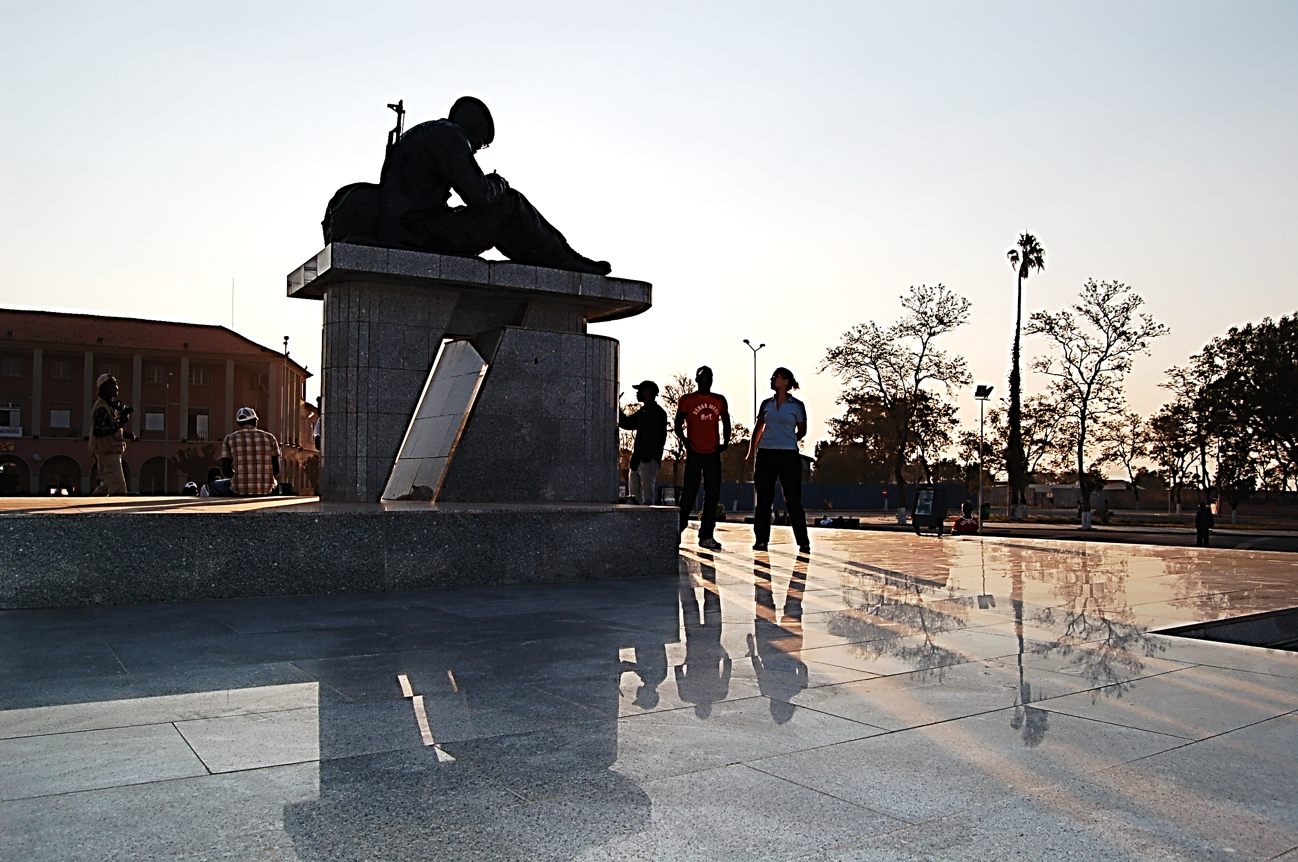
Country Overview
Government & Politics
Government: Presidential republic
Head of Government: President João Manuel Gonçalves Lourenço (MPLA)
MPLA and UNITA remain largest political parties
Notes:
Additional notes from CIA World Factbook:
18 provinces
Constitution: history: previous 1975, 1992; latest passed by National Assembly 21 January 2010, adopted 5 February 2010 amendments: proposed by the president of the republic or supported by at least one third of the National Assembly membership; passage requires at least two-thirds majority vote of the Assembly subject to prior Constitutional Court review if requested by the president of the republic
Executive Branch: elections/appointments: the candidate of the winning party or coalition in the last legislative election becomes the president; president serves a 5-year term (eligible for a second consecutive or discontinuous term); last held on 23 August 2017 (next to be held in 2022)
Legislative Branch: description: unicameral National Assembly or Assembleia Nacional (220 seats; members directly elected in a single national constituency and in multi-seat constituencies by closed list proportional representation vote; members serve 5-year terms) elections: last held on 23 August 2017 (next to be held in August 2022) election results: percent of vote by party - MPLA 61.1%, UNITA 26.7%, CASA-CE 9.5%, PRS 1.4%, FNLA 0.9%, other 0.5%; seats by party - MPLA 150, UNITA 51, CASA-CE 16, PRS 2, FNLA 1; composition - men 136, women 84, percent of women 38.2%

Slide 7

Angola:
History

Slide 8
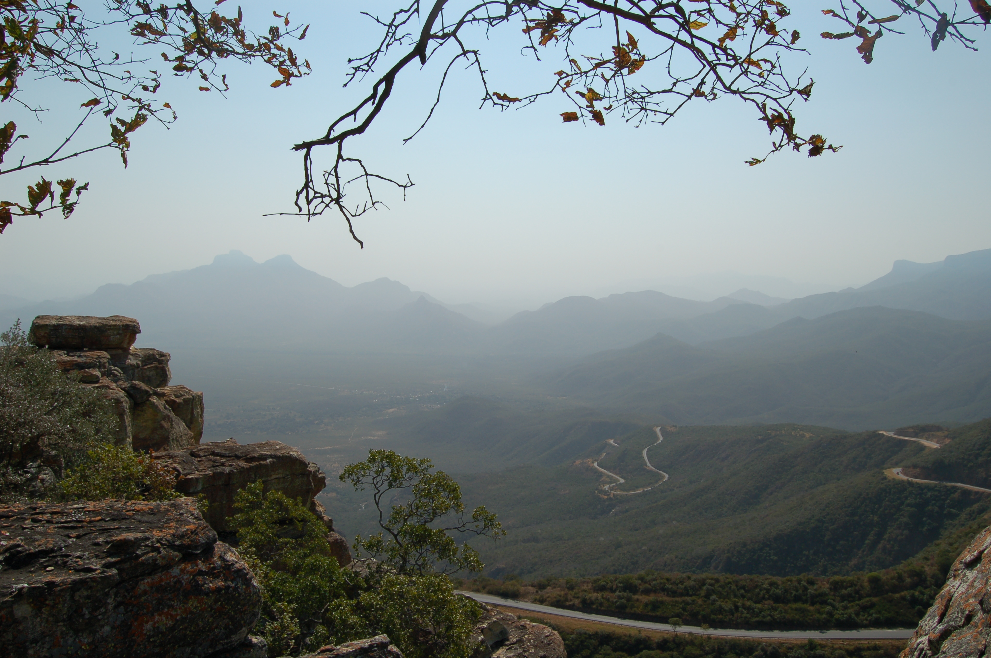
History
Early History
San hunter-gatherers
Bantu speakers
Kingdom of Kongo
Notes:
Additional notes:
Some of the earliest people to live in the area that became the country of Angola include the San hunter-gatherers, who gave way to Bantu speakers before the area became part of the Kingdom of Kongo in the 13th century.
Additional notes from CIA World Factbook:
From the late 14th to the mid 19th century a Kingdom of Kongo stretched across central Africa from present-day northern Angola into the current Congo republics. It traded heavily with the Portuguese who, beginning in the 16th century, established coastal colonies and trading posts and introduced Christianity.

Slide 9
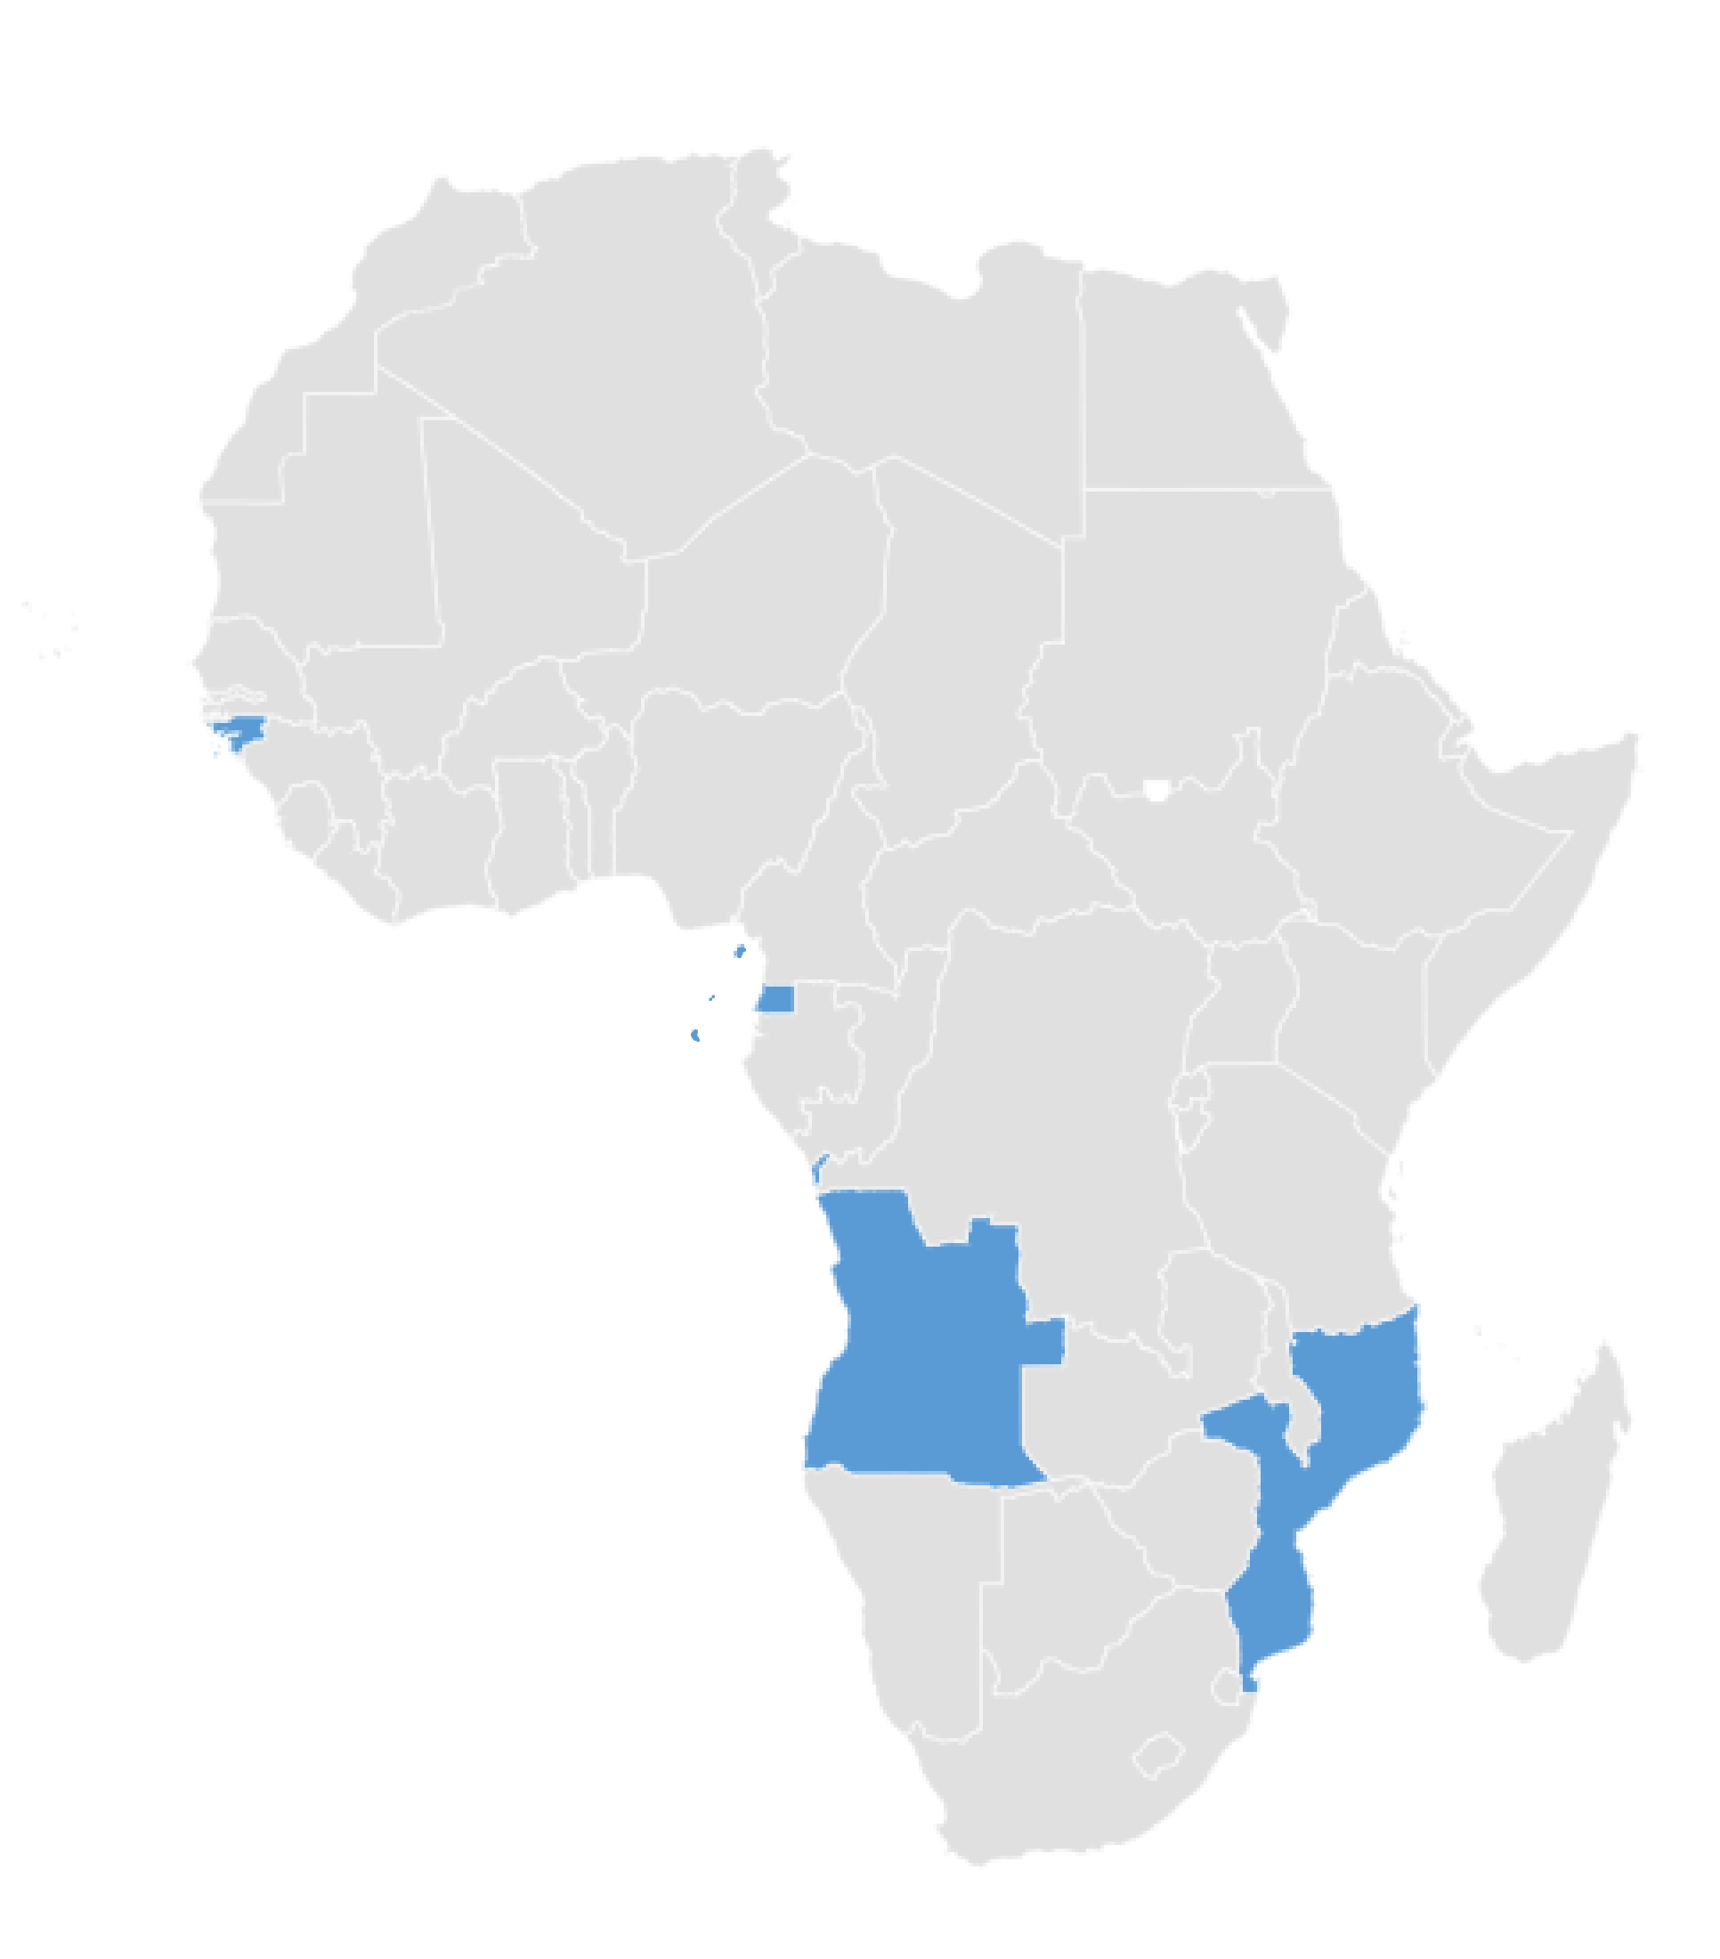
History
Lusophone Africa
Colonial History
1480s: Portuguese arrive
1836: Slave trade abolished
1974: Military coup in Portugal
1975: Independence from Portugal (November 11 is Independence Day)
Notes:
Additional notes from CIA World Factbook:
[The Kingdom of Kongo] traded heavily with the Portuguese who, beginning in the 16th century, established coastal colonies and trading posts and introduced Christianity. By the 19th century, Portuguese settlement had spread to the interior; in 1914, Portugal abolished the last vestiges of the Kongo Kingdom and Angola became a Portuguese colony.

Slide 10
History
Independence & Civil War
1975
Independence from Portugal, civil war begins
1999
UN ends peacekeeping mission
2010
Most recent constitution adopted
1992
National elections held, but fighting continues
2002
Jonas Savimbi is killed, Civil War ends
2017
First successful presidential election
Notes:
This slide provides a timeline and overall context of the Civil War. Subsequent slides will describe the events and major actors.
Additional notes from CIA World Factbook:
1975: Independence from Portugal
1992: National elections held, but fighting continues
1999: UN ends peacekeeping mission
2002: Jonas Savimbi is killed, Civil War ends
2010: New constitution
2017: first successful presidential election
Angola scores low on human development indexes despite using its large oil reserves to rebuild since the end of a 27-year civil war in 2002. Fighting between the Popular Movement for the Liberation of Angola (MPLA), led by Jose Eduardo DOS SANTOS, and the National Union for the Total Independence of Angola (UNITA), led by Jonas SAVIMBI, followed independence from Portugal in 1975. Peace seemed imminent in 1992 when Angola held national elections, but fighting picked up again in 1993. Up to 1.5 million lives may have been lost - and 4 million people displaced - during the more than a quarter century of fighting. SAVIMBI's death in 2002 ended UNITA's insurgency and cemented the MPLA's hold on power. DOS SANTOS stepped down from the presidency in 2017, having led the country since 1979. He pushed through a new constitution in 2010. Joao LOURENCO was elected president in August 2017 and became president of the MPLA in September 2018.

Slide 11
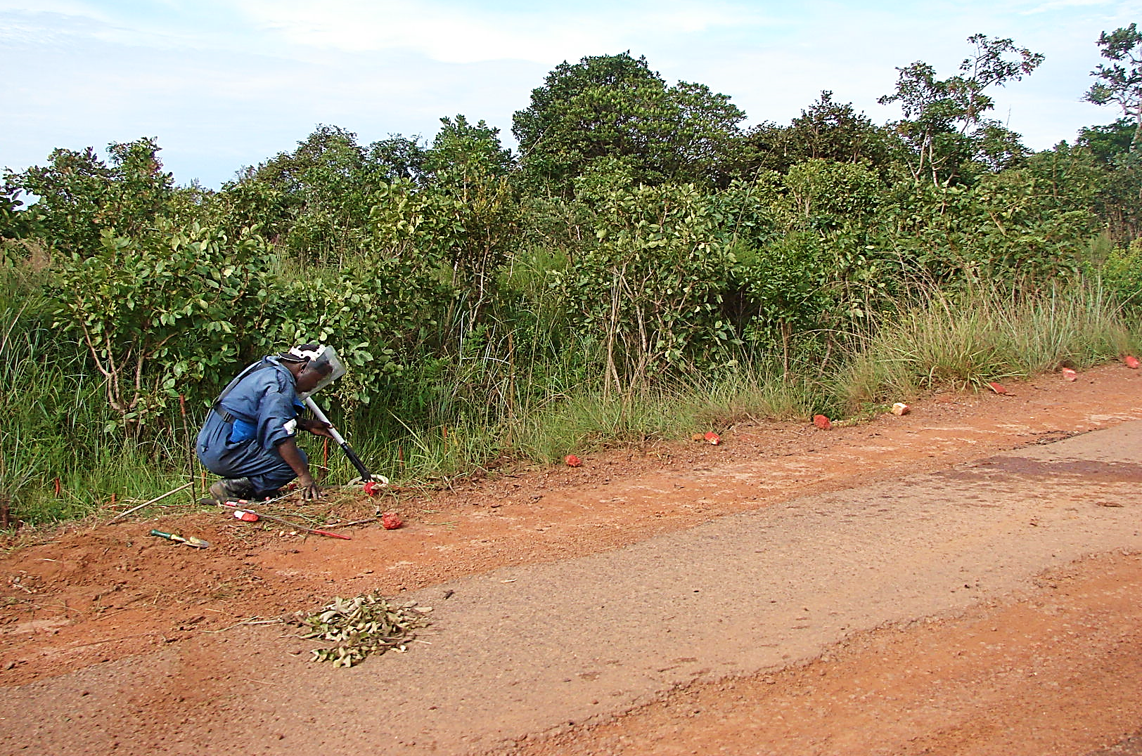
History
Independence & Civil War
MPLA & UNITA
Cold War proxy
Deaths and displacement
  Approx. 500,000 died
  More than 4 million displaced
  More than 400,000 refugees
  Landmines
Notes:
Note: MPLA and UNITA will be discussed in detail on slide 12. Here it is important just to identify them as key actors, 2 guerilla organizations that previously fought against colonialism
Additional notes:
Like much of the rest of Lusophone Africa, Angola gained independence from colonial Portugal after the Portuguese Colonial War (War of Liberation) and, finally, a military coup in Portugal in 1974. Following independence, a struggle for leadership ensued between MPLA and UNITA, two guerilla organizations previously fighting against colonialism. The resulting Civil War became a proxy for the Cold War and ended more than 25 years later in 2002, displacing more than 4 million Angolans (including more than 400,000 refugees) and littering the country with landmines. In 2017, Angola held its first successful presidential election, and the MPLA’s João Lourenço became president

Slide 12
History
Independence & Civil War
MPLA
UNITA
Popular Movement for the Liberation of Angola
Supported by Cuba and the Soviet Union
Founded by Agostinho Neto and led by Eduardo Dos Santos
Currently rule Angola with João Lourenço as president
National Union for the Total Independence of Angola
Supported by apartheid South Africa and the United States
^{Founded by Jonas Savimbi}
Partially funded until the 1990s by “blood diamonds”
Second largest political party in Angola today
Notes:
Additional notes:
Like much of the rest of Lusophone Africa, Angola gained independence from colonial Portugal after the Portuguese Colonial War (War of Liberation) and, finally, a military coup in Portugal in 1974. Following independence, a struggle for leadership ensued between MPLA and UNITA, two guerilla organizations previously fighting against colonialism. The resulting Civil War became a proxy for the Cold War and ended more than 25 years later in 2002, displacing more than 4 million Angolans (including more than 400,000 refugees) and littering the country with landmines. In 2017, Angola held its first successful presidential election, and the MPLA’s João Lourenço became president

Slide 13
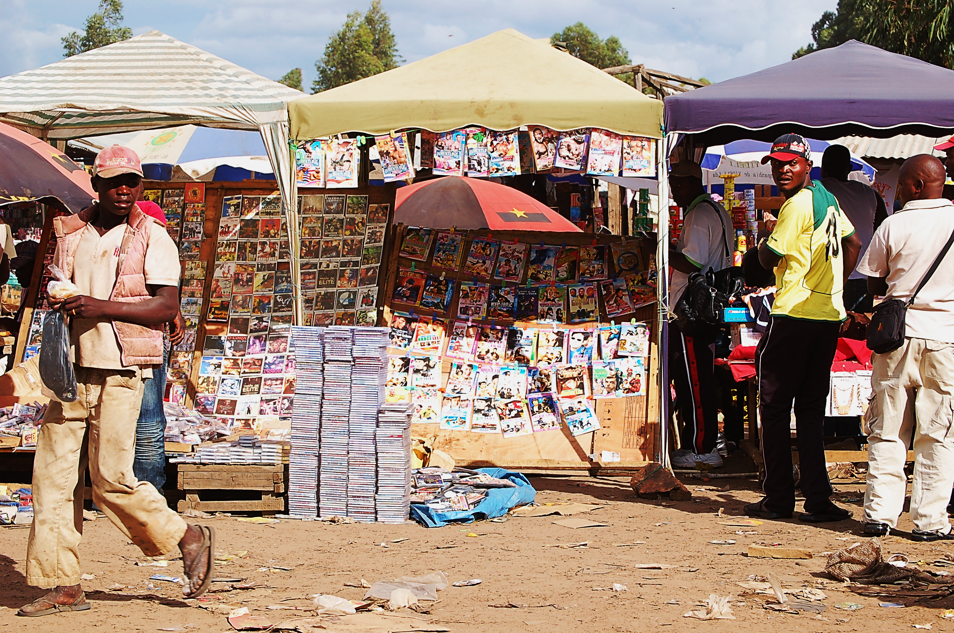
History
Current Events & Issues
Local elections
Landmines
Transition to post-war reconstruction
Youth bulge
Media repression
Notes:
Additional notes from CIA World Factbook:
Local elections postponed during the COVID-19 pandemic and are not yet rescheduled. Dos Santos family is being prosecuted by the current administration for corruption.
Landmines
88,000+ living with injuries from landmines
Demining efforts continue to this day
Transition to post-war reconstruction
Following the civil war, many international interventions had to pivot from humanitarian assistance to recovery/reconstruction and, eventually, development if they wanted to continue working.
Young country
With an average age of 15.9, Angola is one of the youngest countries in the world. Studies have shown correlations between countries with such a “youth bulge” and high youth unemployment and potential for civil unrest.
Media repression
According to Reporters Without Borders, “the few TV channels, the radio stations and the 20 or so newspapers and magazines are still very largely controlled or influenced by the government and ruling party…the media continue to push for the decriminalisation of press offences without success. And censorship and self-censorship, a hangover from the years of repression under the former regime, are also still widespread.”
Freedom House gives Angola a “not free” global freedom score and “partially free” for internet freedom score

Slide 14

The
Development
Industry

Slide 15








Implementing Inequality
Development Landscape
Key topics:
Governance, education, food assistance, health, water and sanitation, human rights, livelihoods, environment, gender, and security
Notes:
Instructor note: this slide can be used to assess student familiarity and understanding of the development industry. Key topic examples and logos will appear separately so instructors can give students a chance to share what they know already.
Logos included in these slides do not imply endorsement or affiliation and are included as examples and for discussion purposes only.

Slide 16
Implementing Inequality
Humanitarian/Development Spectrum
Development
Humanitarian Assistance
^{Long-term}
^{Goals} ^{are life-building}
“International development” typically practiced in “developing” countries
Attempts to address systematic challenges through economic, social, and political development
^{Short-term}
Goals are life-saving and life-sustaining
Typically occurs in disaster, crisis, and/or conflict zones; more reactionary and response-driven
Attempts to address immediate needs through material and logistical assistance
Notes:
Instructor note: descriptions of development and humanitarian assistance appear after the titles to allow time to solicit student thoughts about the differences if desired.
Discussion questions:
Development and humanitarian assistance are usually seen as two ends of a continuum. How might organizations that address each be the same? Different? What happens to organizations that work in humanitarian assistance when the disaster, crisis, or conflict is over? (note: many organizations working in Angola during the civil war had to answer this very question once the war ended).
What factors might affect how power structures in development and humanitarian assistance structures are the same or different?

Slide 17
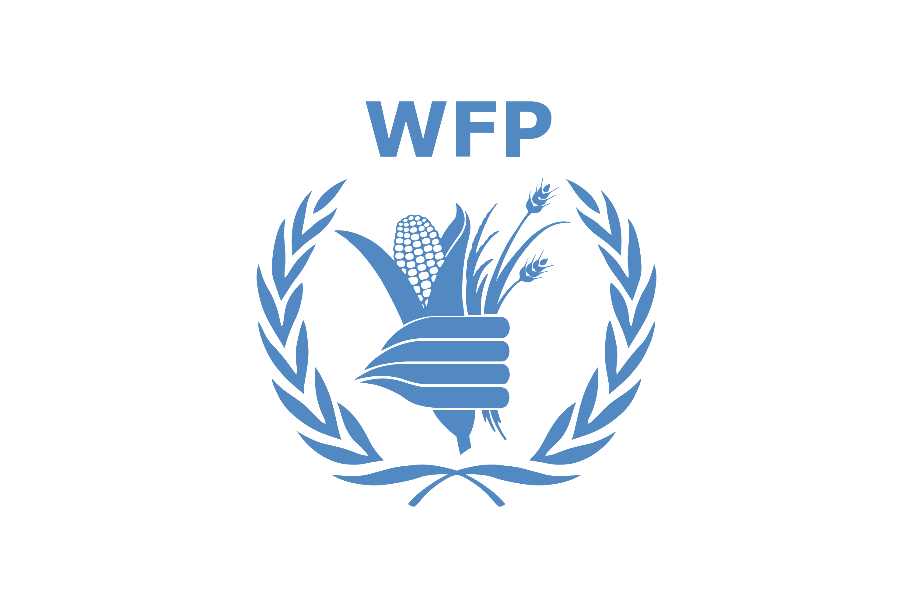




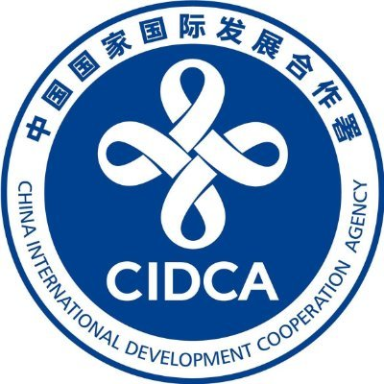


Implementing Inequality
Industry Players and Processes
Multilateral
Bilateral
Assistance given by multiple countries through an international organization
Assistance given directly from one country to another, often as part of the donor country’s foreign policy initiatives
Notes:
Logos included in these slides do not imply endorsement or affiliation and are included as examples and for discussion purposes only.

Slide 18







Implementing Inequality
Industry Players and Processes
NGOs/Non-profits
For-Profit Contractors
May receive funds from multiple governments through grants and contracts as well as from private donors through fundraising activities with the public; often direct implementers
Contract with donors, particularly bilateral donors, to implement development projects; like nonprofits, they may specialize in development or consult within many fields
Notes:
Logos included in these slides do not imply endorsement or affiliation and are included as examples and for discussion purposes only.

Slide 19




Implementing Inequality
Industry Players and Processes
Private Foundations
Private Sector/CSR
Funding comes from a single individual or family who may gain tax advantages; may do some implementation and provide grants
Private sector businesses engaging with and funding development through corporate foundations, public private partnerships, and corporate social responsibility (CSR) engagements to increase positive brand recognition and gain tax advantages
Notes:
Logos included in these slides do not imply endorsement or affiliation and are included as examples and for discussion purposes only.

Slide 20
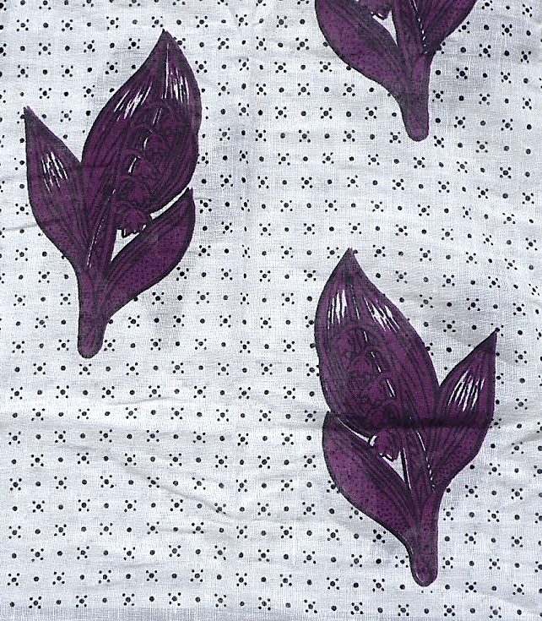
Implementing
Inequality

Slide 21
Implementing Inequality
Introduction
Follows the GGAP (“Good Governance in Angola Program”)
  Implemented from 2007-2012
  Goals:
    Improve capacity of local government
    Improve civic participation
Ethnographic research over 12 months
  Participant observation
  Interviews
Notes:
The GGAP was a democratization and governance intervention implemented from 2007 to 2012, beginning just five years after the end of Angola’s civil war and not long after the country’s first successful parliamentary elections. The GGAP was funded by a Western bilateral aid agency (called WestAid in the book) with contributions from an oil company and a diamond company. It was implemented through the collaborative efforts of three large international NGOs (American, British, and Canadian) with two main objectives: improve the capacity of local government employees and work with local people to improve civic participation, namely through new community-based organizations called Area Development Organizations, or ODAs, for their acronym in Portuguese.
Ethnographic research took place over 12 continuous months, including the GGAP’s Phase I midterm review, and was comprised of participant observation and interviews (usually in Portuguese) at the main NGOs’ headquarters in Luanda as well as several field offices.

Slide 22
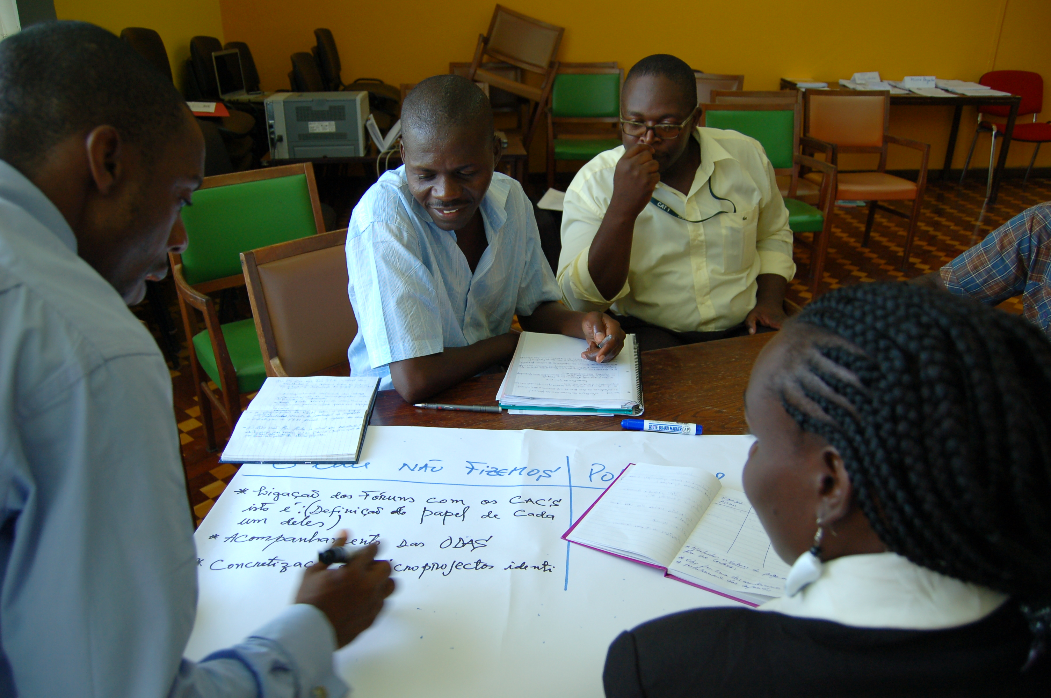
Implementing Inequality
Key Concepts
Development encounter
Implementariat
Notes:
Development encounter
Theoretical analyses of the international development industry often examine the “development encounter,” a lens which focuses on the relationship between development agents and recipients and which is often erroneously mapped onto global hierarchies of race and nation. In privileging these encounters, however, a large number of development workers and tasks are easily overlooked or misunderstood.
Implementariat
As presented in this book, the development implementariat is the class of development workers made up of those rank-and-file staff members working in developing countries for international programs and organizations. The defining feature of the implementariat is that this class of development workers is tasked to realize development plans and policies rather than to determine what they should be from the outset.

Slide 23
Implementing Inequality
Additional Key Concepts
Audit culture
Development hierarchies
Imagination work
Interpretive labor
Praxiscape
Principal-agent thinking
Shadow work
Social/relational work
Street-level bureaucracy
Structural violence
Notes:
These are in no particular order.
While discussing additional theory and concepts, you can choose the most important to your course and any selections that may be taught. This slide can also be adapted for students to begin thinking about these concepts through a KWL (Know-Wonder-Learned) or similar structure to spark discussion.

Slide 24
Discussion
What do you think are the world’s biggest development challenges today?
What actions can address these challenges?
Who do you think should be involved in development interventions and why?
Notes:
These questions can be interspersed throughout the presentation

